Slide 1


SEWER[MANHOLE] MONITORING SYSTEM
BY TESLA GROUP @ CORE2WEB

Slide 2
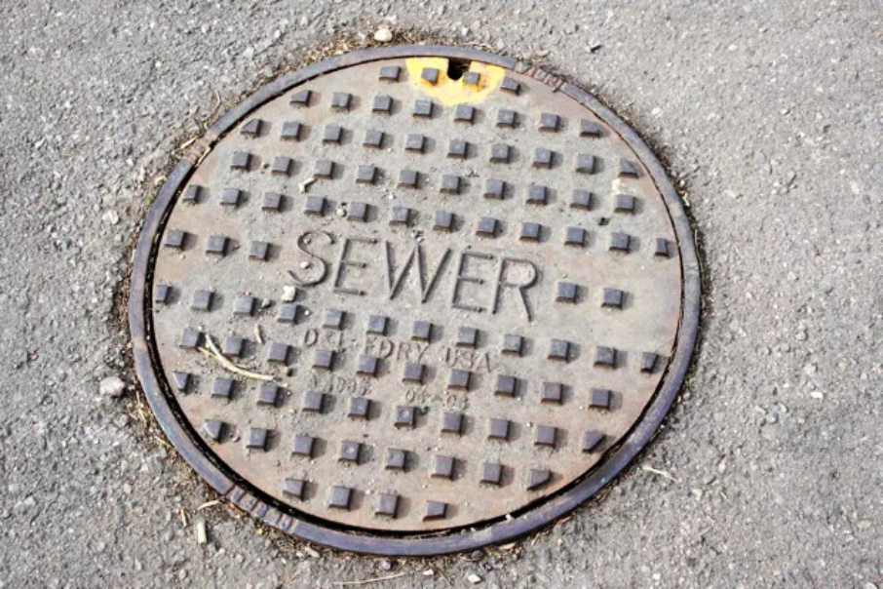

Slide 3
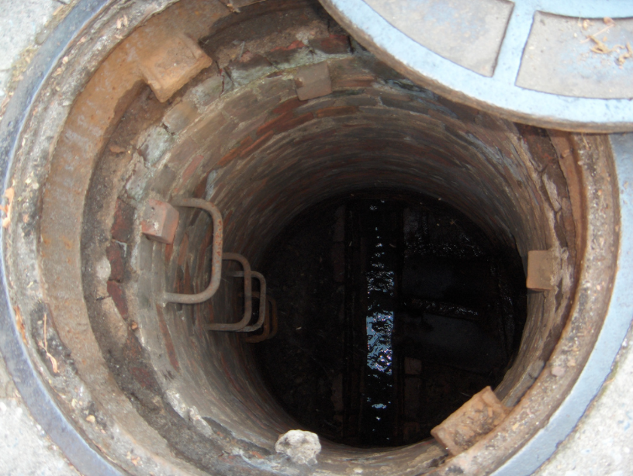

Slide 4

WHY SEWER MONITORING IS NECESSARY ??
01
TO KNOW LID IS OPEN OR NOT
02
TO KNOW THE CONCENTRATION OF HARMFUL GASES
03
HIGHLY CREATIVE
TO KNOW WEATHER THE SEWER IS CHOCKED UP ??

Slide 5
STATISTICS
01
NO. OF MANHOLES PER KM = 5
02
CITY ROAD LENGTH = 240,000/.020=12,000,000 KM.
03
NO. OF MANHOLES = 12 MILLION * 5 = 60 MILLION MANHOLES

Slide 6
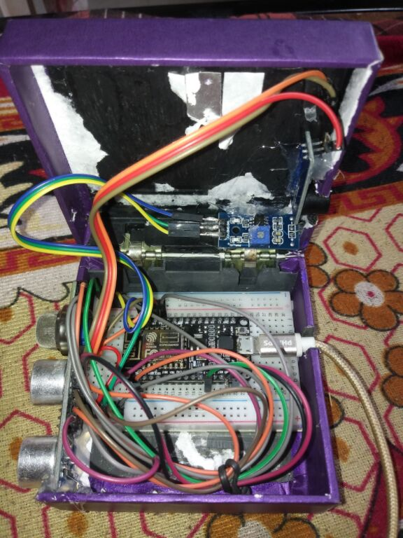
BUZZER
LDR Digital
Module
MQ 2
Gas Sensor
Node MCU
Ultrasonic
HCSR - 04

Slide 7
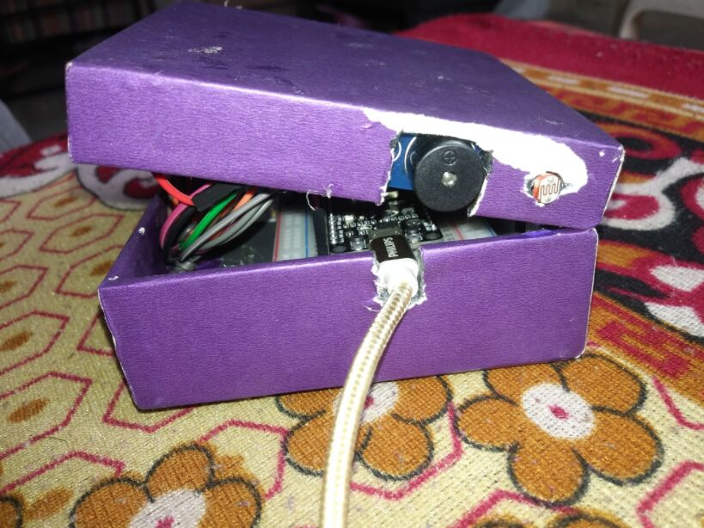

Slide 8




Slide 9
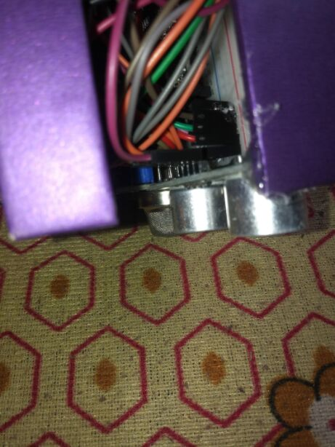

Slide 10
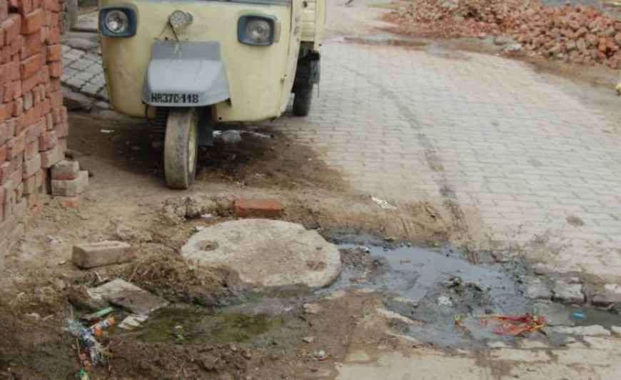

SEWER HAS OVERFLOWED DUE
TO CHOCKING

Slide 11
ULTRASONIC

Slide 12
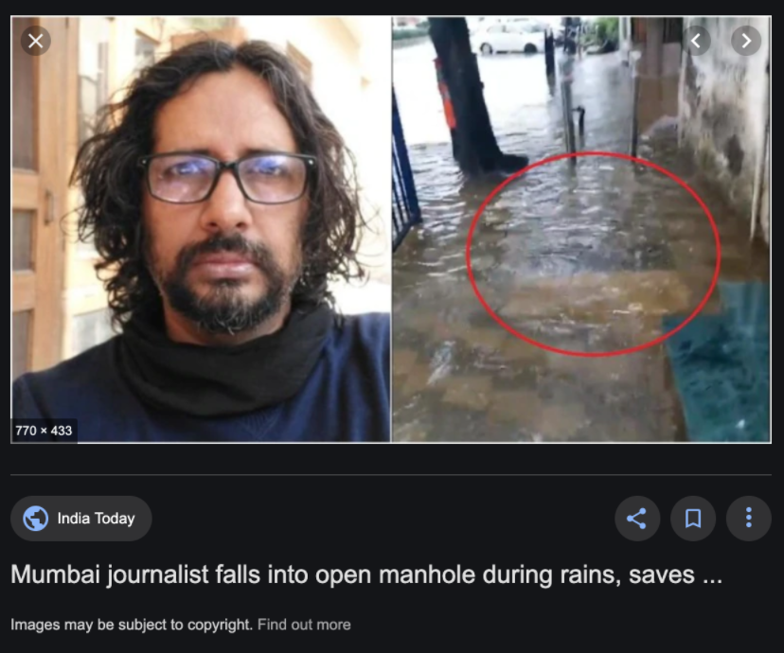

Slide 13
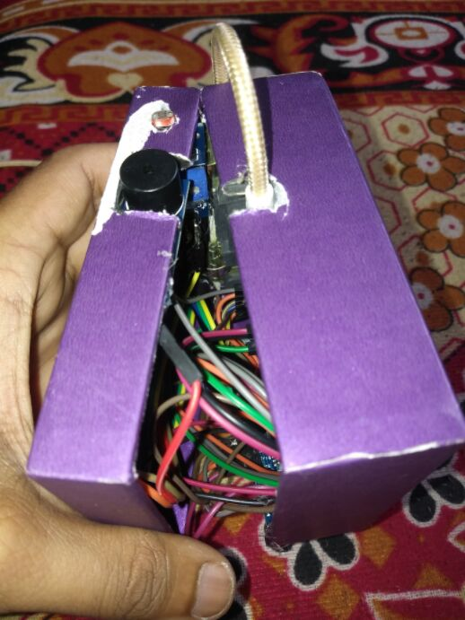
LDR
BUZZER

Slide 14


THINGSPEAK
CLOUD
DEVICE
MOBILE APP

Slide 15

REASONS
RESTRICTS
YOU
SASHI BAGAL SIR

Slide 16
THANKS
A LOT
GANESH AND KRUSHNA @ TESLA LEADERS
PRAMOD SIR & SOMESH SIR
SACHIN DADA AND MANAGEMENT

